Slide 1
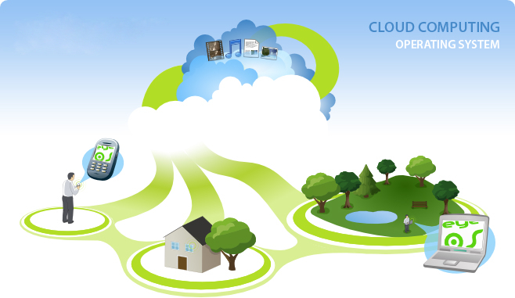

James Small
Garrett Cuillier
David Kagawa-Aguirre

Slide 2
What is eyeOS?
eyeOS is an open source web desktop
A web desktop or webtop is a desktop environment embedded in a web browser or similar client application. It is a virtual desktop running in a web browser.
It acts as a platform for web applications written using the eyeOS Toolkit. It includes a Desktop environment with 67 applications and system utilities. It is accessible by portable devices via its mobile front end.

Slide 3
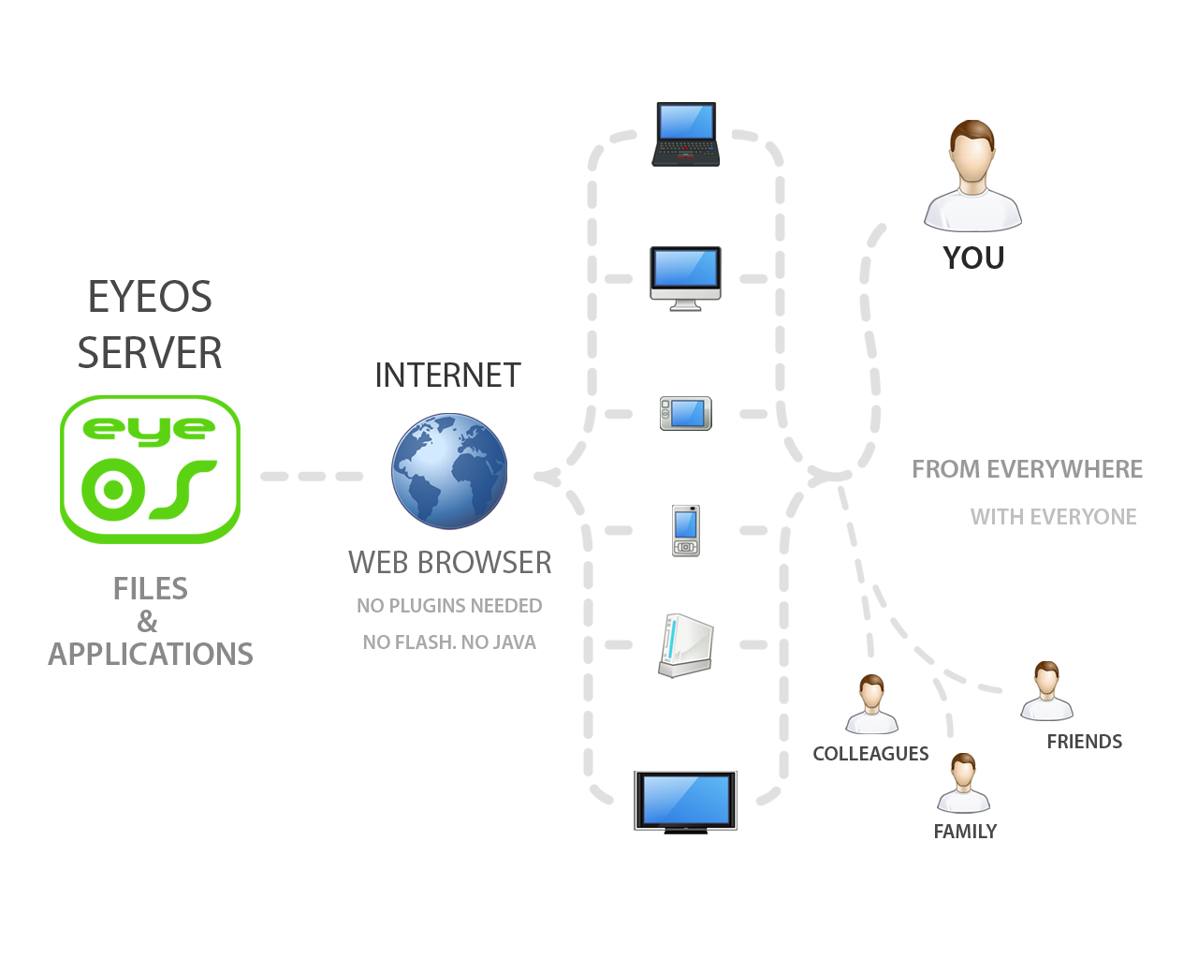

Slide 4
eyeOS Specifications
Initial release | August 1, 2005 (2005-08-01)
Stable release | 2.5 / May 14, 2011; 12 months ago (2011-05-14)
Development status | Active
Written in | PHP, XML, JavaScript
Platform | Cross-platform
Available in | Multilingual
Type | Web application
License | AGPL
Website | Official eyeOS Website

Slide 5
Advantages of eyeOS
Convenience
A personalized desktop on every supported client device
Mobility
Access your desktop anywhere there is a supported client device
Session management
Server-side session management allows roaming users to access restored sessions from anywhere
High availability
From a single device access Windows, UNIX, Linux, and Mainframe applications, all at the same time
Minimal hardware requirements for client devices (except for rendered technologies such as Flash/Flex/SilverLight)

Slide 6
Drawbacks of eyeOS
Security
256-bit encryption and access control lists, this can be easily safe-guarded.
Speed
network latency or congestion can intermittently slow webtop activity
Application features
Some webtop delivered applications may not contain the full feature set of their traditional desktop counterparts
Network Access
Web desktops require access to a network
Central control (advantage?)
Updates & installs typically must be performed by an administrator on the server side

Slide 7
Who would use a Webtop?
Schools
Small businesses
People who travel a lot
Webtops and thin clients tend to save these groups money while still being convenient. For example a school would only have to install the operating system on the server and all of the other desktops could be simple boxes with an internet connection. This saves money on maintenance and start up. Also if updates need to be performed, its much easier to do it on one system instead of many systems.

Slide 8
Common Uses for EyeOS
The users at the Public Server at http://eyeOS.info:
These users, over 50,000 of them, commonly use EyeOS for these tasks:
Share files
Office tasks - e.g. creating private word documents, using the calendar and agenda. They do this so they can access the files from different computers. One user mentioned that he creates docs at home and then prints them out in the office, using eyeEdit.
Upload and download files in places were FTP is not allowed (e.g. the office) and use eyeOS to move files.
Chat / IM - eyeMessages (their IM app) has a lot of traffic right now,
Play games

Slide 9
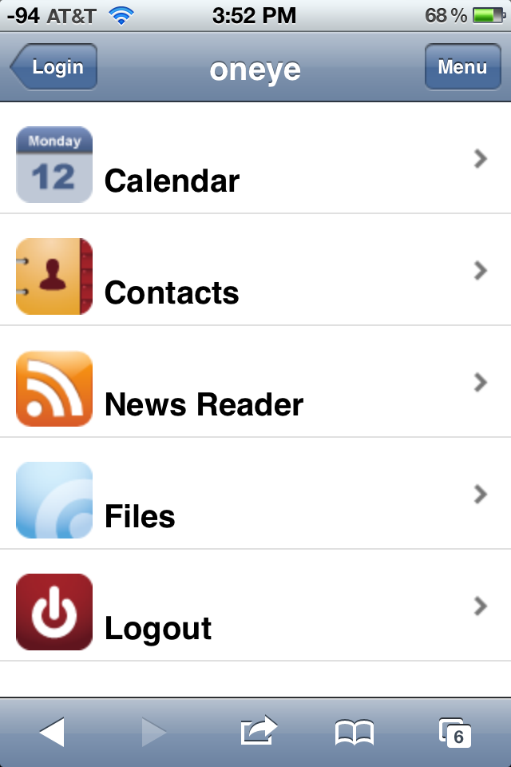
iPhone Interface

